Slide 1
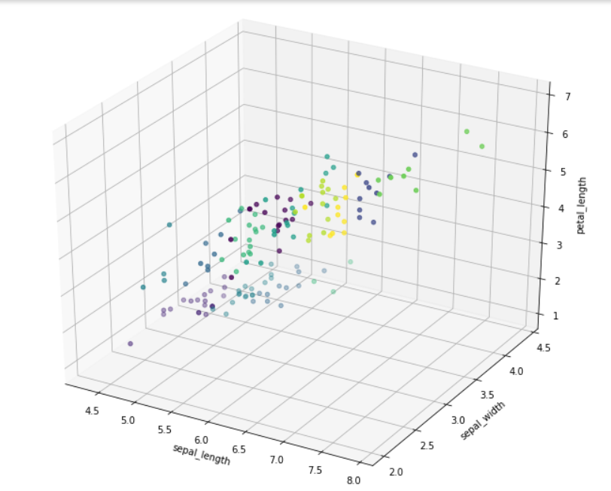
K-MEANS CLUSTERING USING APACHE PYSPARK
Team Members :
N.Akhil – 19071A12C1
N.Akshay – 19071A12C2
A.Sai.Shreya – 19071A12C3
A.Jabilli – 19071A12C4
B.Vyooha – 19071A12C5
Project Guide :
Dr.N.Sudhakar Yadav
Assistant Professor,
VNRVJIET

Slide 2

Agenda
Abstract
Problem Definition
Methodology
Algorithm Description
Workflow
Implementation
Results

Slide 3
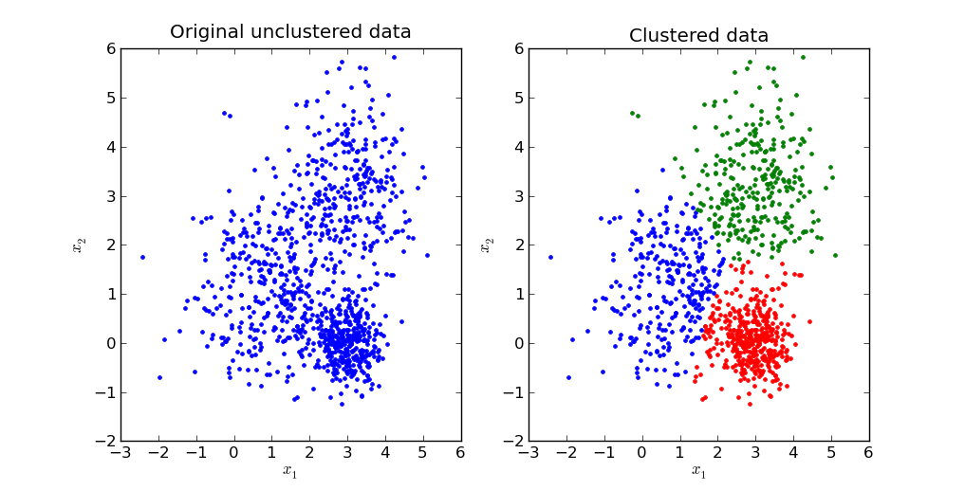
Abstract
Data clustering is an important data exploration technique with many applications in data mining. K-means is one of the most well-known methods of data mining that partitions a dataset into groups of patterns, many methods have been proposed to improve the performance of the K-means algorithm.

Slide 4
Problem Definition
Imagine you have a large dataset of observations, but there is no grouping information or labels for the data points. Through clustering we can generate groups comprised of observations with similar characteristics. For example, if you have customer data, you might want to create sets of similar customers and then target each group with different types of marketing.
We can also identify the requirements in market segmentation, document clustering, image segmentation and image compression, etc.

Slide 5
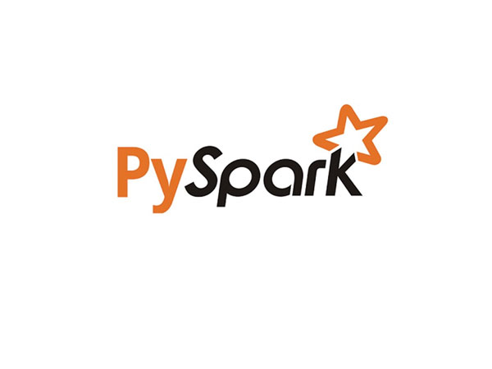
Methodology
PySpark :
PySpark is the Python API for Apache Spark, an open source, distributed computing framework and set of libraries for real-time, large-scale data processing.
PySpark is an interface for Apache Spark in Python. It not only allows you to write Spark applications using Python APIs, but also provides the PySpark shell for interactively analyzing your data in a distributed environment.

Slide 6
MLlib:
MLlib is Spark's machine learning (ML) library. Its goal is to make practical machine learning scalable and easy. At a high level, it provides tools such as: ML Algorithms: common learning algorithms such as classification, regression, clustering, and collaborative filtering.
Google Colab:
Colaboratory, or “Colab” for short, is a product from Google Research. Colab allows anybody to write and execute arbitrary python code through the browser, and is especially well suited to machine learning, data analysis and education.

Slide 7
Algorithm Description
The K Means Clustering algorithm finds observations in a dataset that are like each other and places them in a set. The process starts by randomly assigning each data point to an initial group and calculating the centroid for each one. A centroid is the center of the group. Note that some forms of the procedure allow you to specify the initial sets.
Then the algorithm continues as follows:
It evaluates each observation, assigning it to the closest cluster. The definition of “closest” is that the Euclidean distance between a data point and a group’s centroid is shorter than the distances to the other centroids.
When a cluster gains or loses a data point, the K means clustering algorithm recalculates its centroid.
The algorithm repeats until it can no longer assign data points to a closer set.

Slide 8
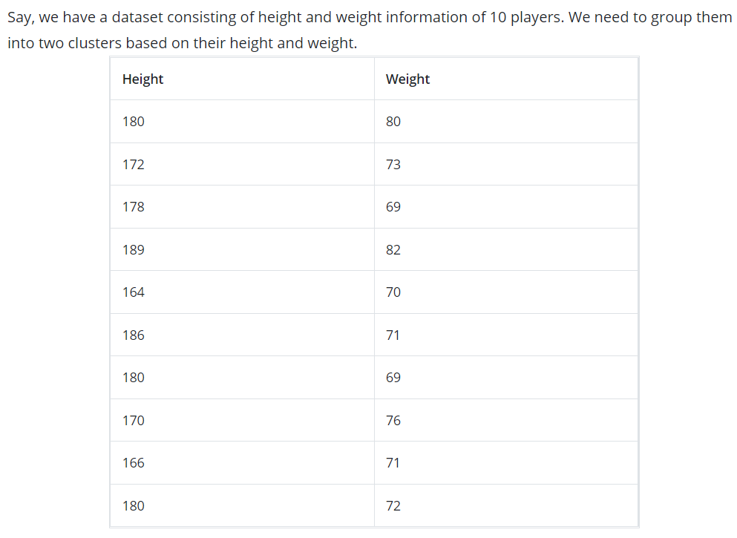

Slide 9
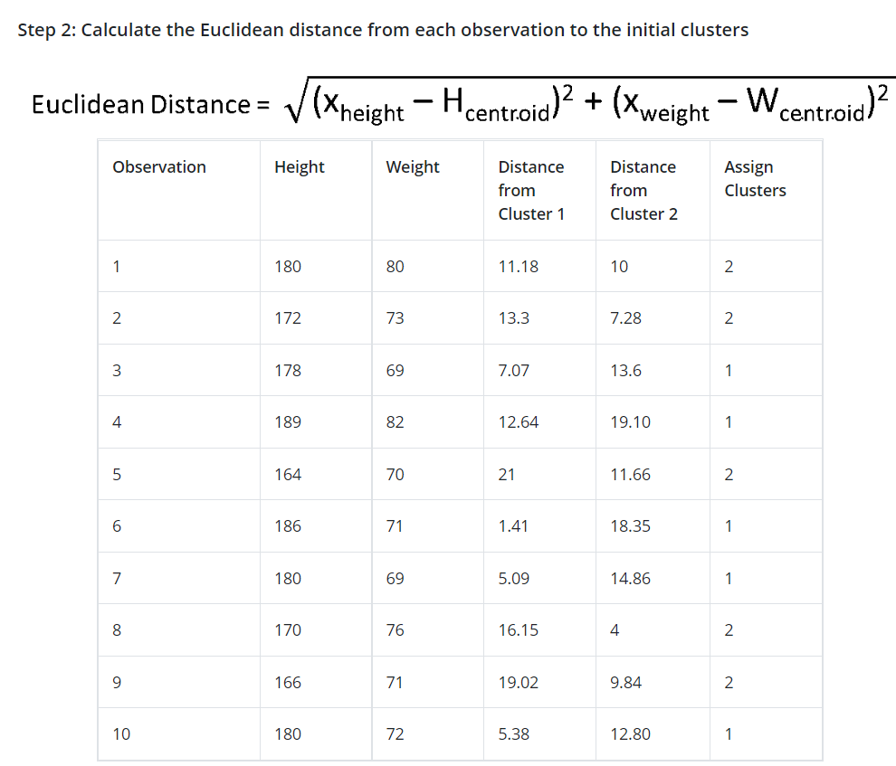
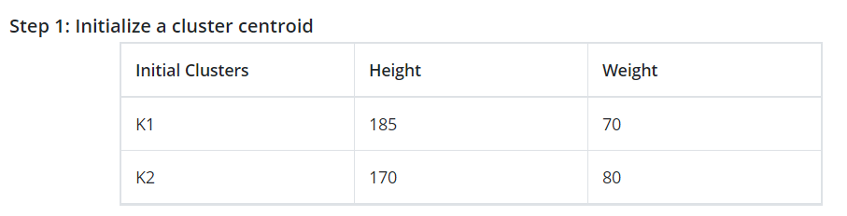

Slide 10
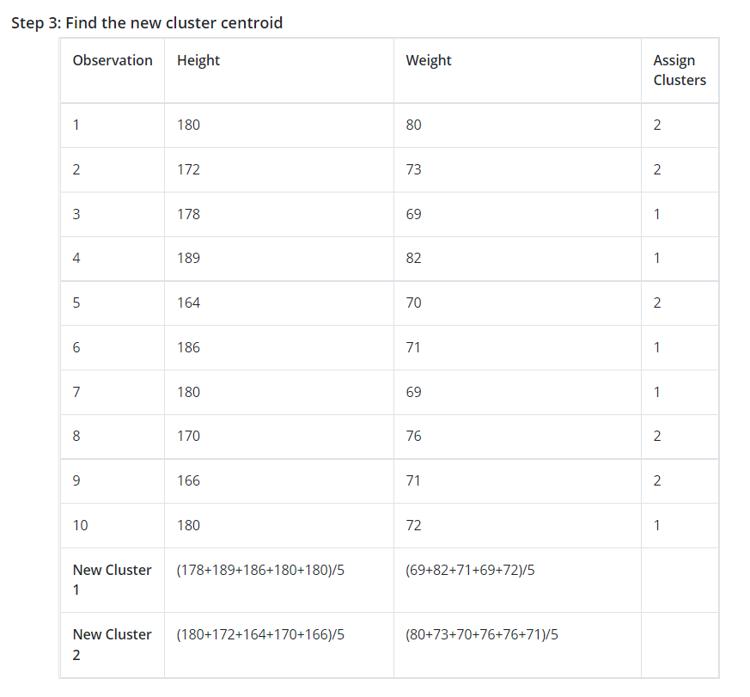

Slide 11
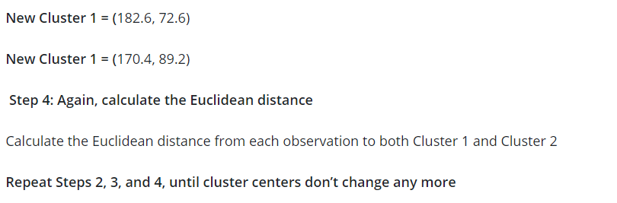

Slide 12
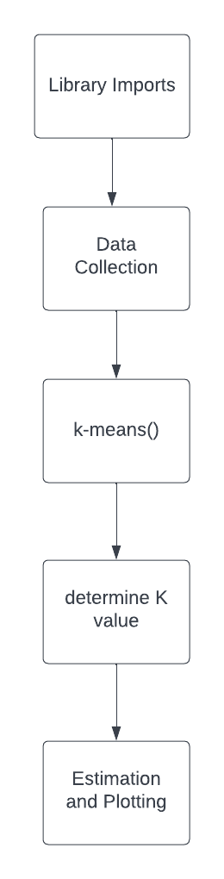
Workflow

Slide 13
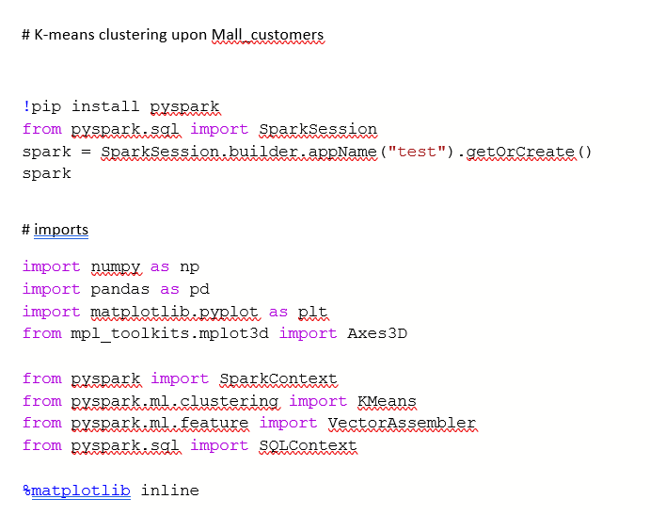
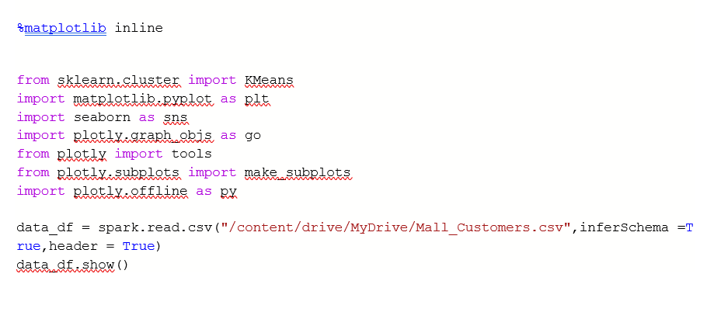
Implementation

Slide 14

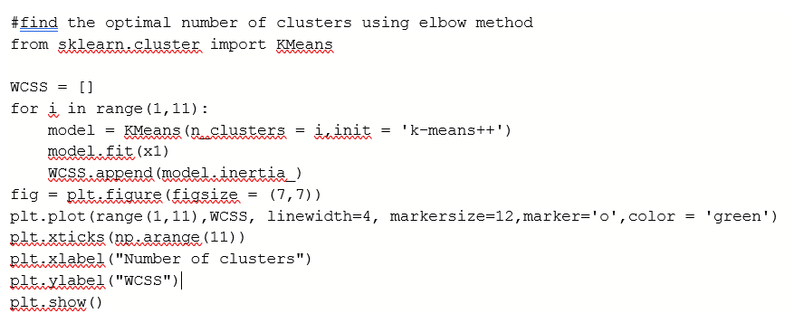
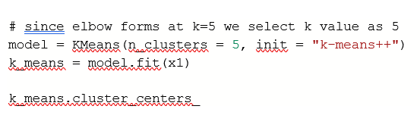

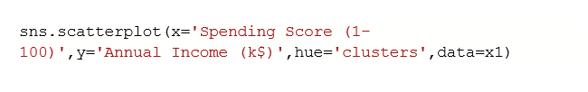


Slide 15
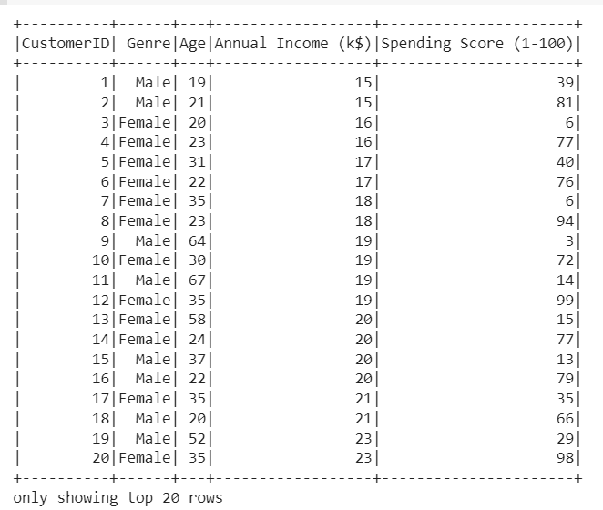
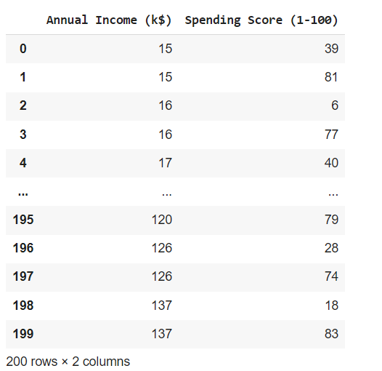
Results

Slide 16
